Slide 1
Q-Learning Maze Solver
Exploring Reinforcement Learning in a Grid Environment
Sai Kushal KS
Arnav Upadhyay

Slide 2
Introduction
The objective of this project is to create an intelligent agent that navigates a maze from a starting position to a goal.
It implements a dynamic maze generation system that uses a Q-learning model for optimal navigational strategies.
It also visualizes the learning process in real time to enhance understanding of the decision making.

Slide 3
Reinforcement learning
Reinforcement Learning : A branch of machine learning where an agent learns to make decisions by interacting with an environment.
The key components are:
Agent: The learner or decision-maker.
Environment: The space in which the agent operates.
Actions: Possible moves the agent can make.
Rewards: Feedback from the environment based on the agent's actions.
Q-Learning:
A model-free reinforcement learning algorithm.
Uses a Q-table to estimate the value of taking a particular action in a given state.
Employs the Bellman equation to update Q-values.

Slide 4
Understanding Q-Learning
Q-learning is a model-free reinforcement learning algorithm used to learn the value of actions in a given state, aiming to maximize cumulative rewards over time.
The objective is to find the optimal action-selection policy, which tells the agent what action to take under different circumstances to achieve the highest long-term reward.
Q-Values (Action Values):
Q-values represent the expected future rewards for taking a certain action in a given state.
Q(s,a)Q(s, a)Q(s,a) indicates the expected utility of taking action A in state S.
Epsilon-Greedy Strategy:
A common approach to balance exploration and exploitation:
With probability ϵ, choose a random action (exploration).
With probability 1−ϵ, choose the action with the highest Q-value (exploitation).
Epsilon Decay: Over time, ϵ is reduced to favour exploitation as the agent gains more knowledge.

Slide 5

Understanding q-learning
Q-Learning Update Rule:
The core update formula used to refine Q-values:
Where:
α = Learning rate (controls how much new information overrides old information).
r = Immediate reward received after taking action A from state S.
γ = Discount factor (determines the importance of future rewards).
s′ = Next state after taking action A.
Benefits of Q-Learning:
Model-Free: Does not require a model of the environment, making it flexible and applicable to various problems.
Convergence: Under certain conditions (e.g., sufficient exploration), Q-learning is guaranteed to converge to the optimal policy.

Slide 6
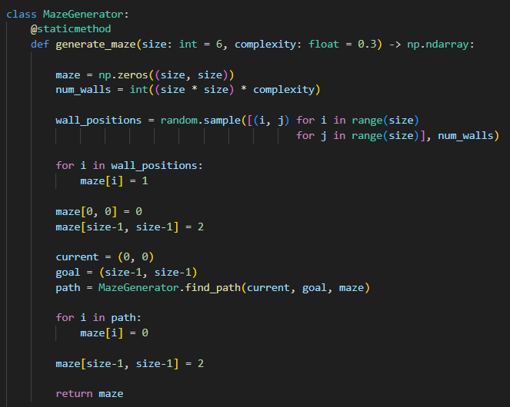
Maze Generation
Maze Initialization: A 2D NumPy array is created to represent the maze, initialized to zeros (empty spaces).
Wall Generation: Random positions are selected to place walls based on the complexity parameter.
Start and Goal: The starting position (top-left corner) is set to 0, and the goal position (bottom-right corner) is set to 2.
Path Creation: The find_path function ensures that there is a valid path from start to goal by modifying the maze accordingly.

Slide 7
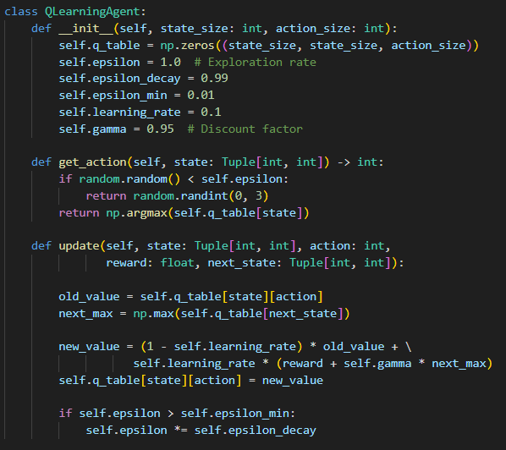
Q-Learning Agent
Q-table Initialization: A 3D array representing the Q-values for each state-action pair is created.
Action Selection : the get_action method uses the epsilon-greedy strategy to balance exploration and exploitation.
Q-value Update: The update method adjusts the Q-value based on the reward received and the maximum expected future reward, implementing the Q-learning formula

Slide 8
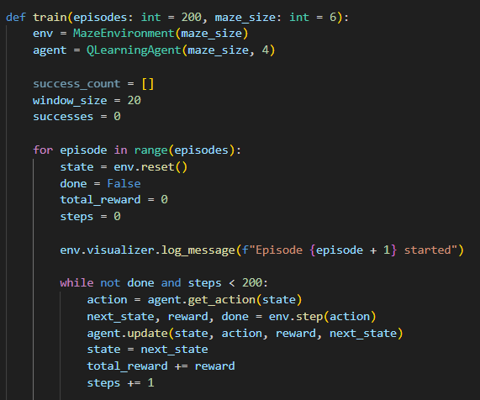
Training Process
Environment and Agent Creation: A new maze environment and a Q-learning agent are instantiated.
Episode Loop: For each episode, the agent resets the environment, takes actions based on the learned Q-values, and updates the Q-table after each step.
Termination: The loop continues until the goal is reached or the maximum number of steps is exceeded.

Slide 9
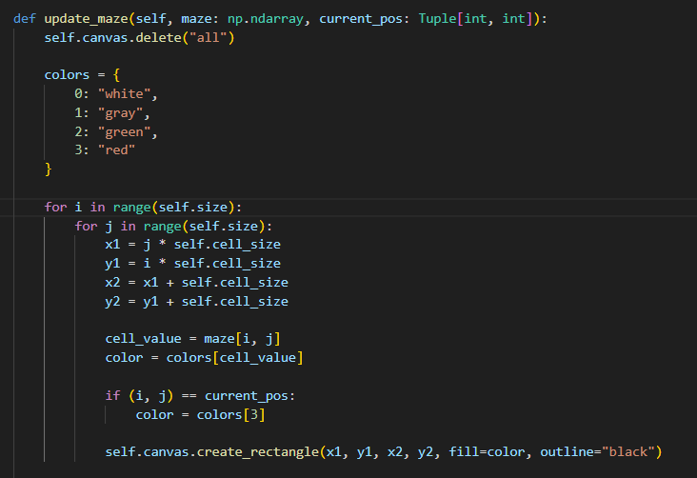
Visualization
Maze Update: the update_maze method redraws the maze each time the agent moves, highlighting the current position.
Color Mapping: Different colours represent empty spaces, walls, the goal and the agent.
Canvas Drawing: The method creates rectangles on the canvas to visually represent the maze state.

Slide 10
results
Episodes: The agent was trained over 200 episodes, allowing it to learn from repeated interactions with the maze environment.
Success Rate : The agent successfully reached the goal in approximately 80% of episodes after initial training.
Notable improvement observed in the agent's ability to navigate the maze as episodes progressed.
Epsilon Decay : Initial exploration rate (epsilon) was set to 1.0, gradually decaying to 0.01.
This strategy allowed the agent to explore the maze freely at first and exploit learned paths as it trained.
Reward Structure : Positive Rewards: +100 for reaching the goal.
Negative Rewards: -1 for valid moves and -5 for hitting walls.
The reward structure reinforced goal-oriented behavior, encouraging the agent to seek the goal while avoiding walls.
Average Steps to Goal:
The average number of steps to reach the goal decreased from approximately 50 steps in the first few episodes to around 10 steps in later episodes.

Slide 11
conclusion
Effective Learning: The Q-learning algorithm successfully trained the agent to navigate a dynamic maze environment, showcasing the capability of reinforcement learning in problem-solving.
Adaptability: The agent adapted to its environment, significantly improving its performance over time, which demonstrates the potential for complex decision-making tasks.
The project not only serves as a practical demonstration of Q-learning but also paves the way for further exploration into reinforcement learning techniques.
Emphasizing the importance of visualization and tracking metrics in understanding and refining machine learning models enhances both educational and practical applications.

